Slide 1

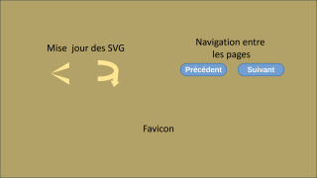
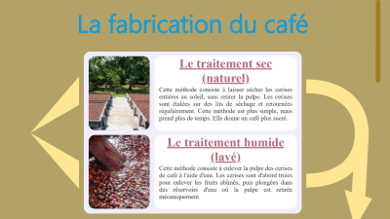



Structure générale
Scripts
Galerie d’art

Slide 2
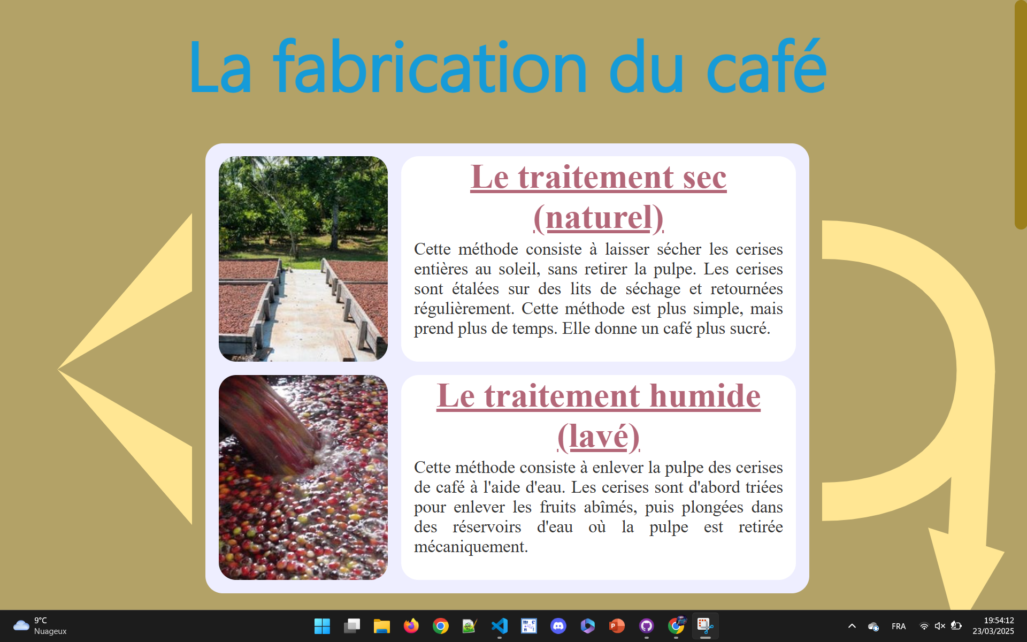

Slide 5
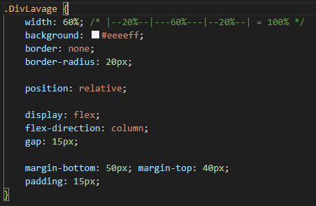


Slide 6
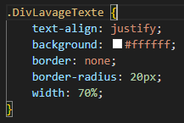


Slide 7
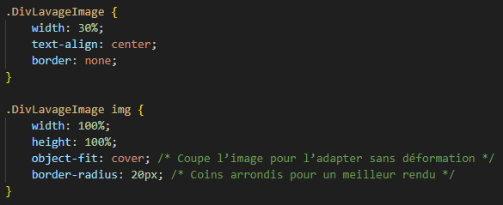
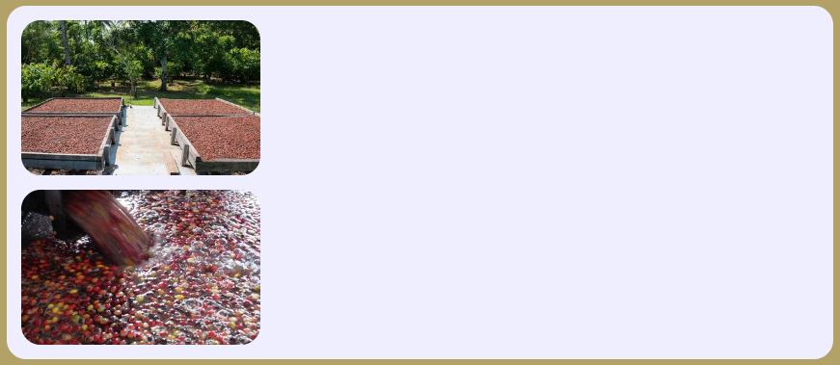

Slide 8
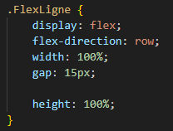

Slide 9










Slide 10
Mise jour des SVG

Slide 11
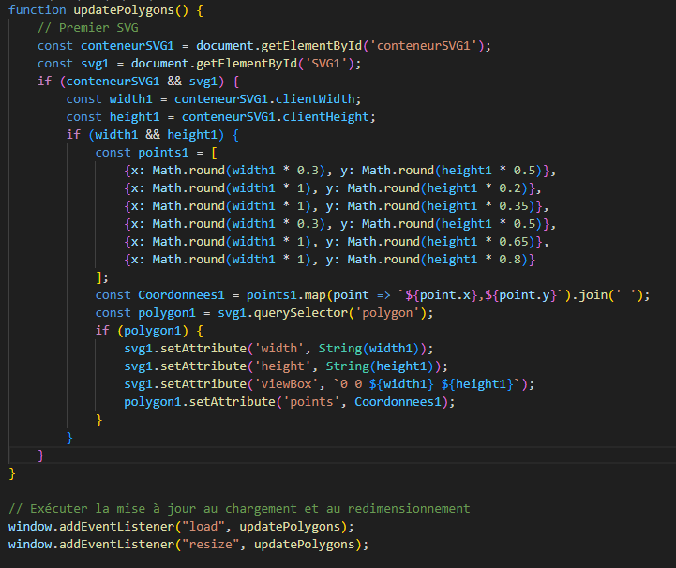

Slide 12
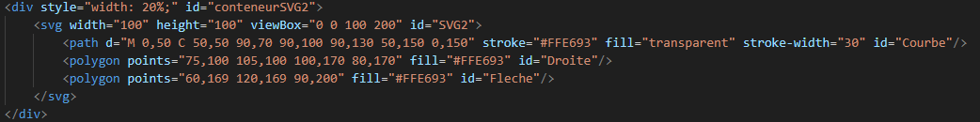

Slide 14
Navigation entre
les pages

Slide 15
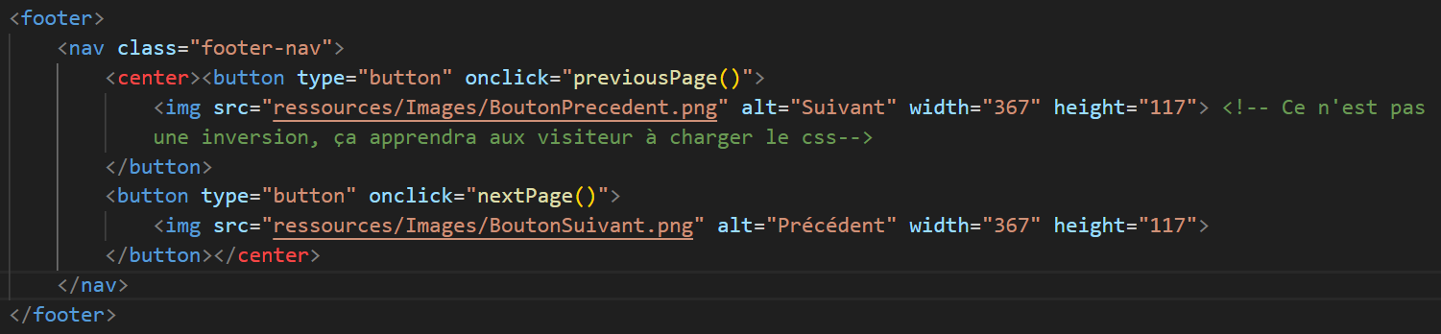

Slide 16
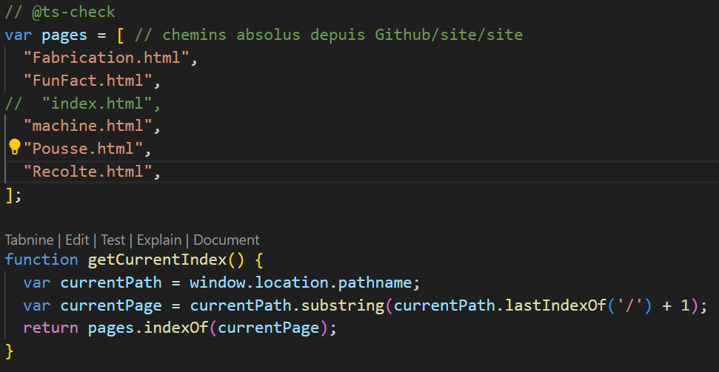
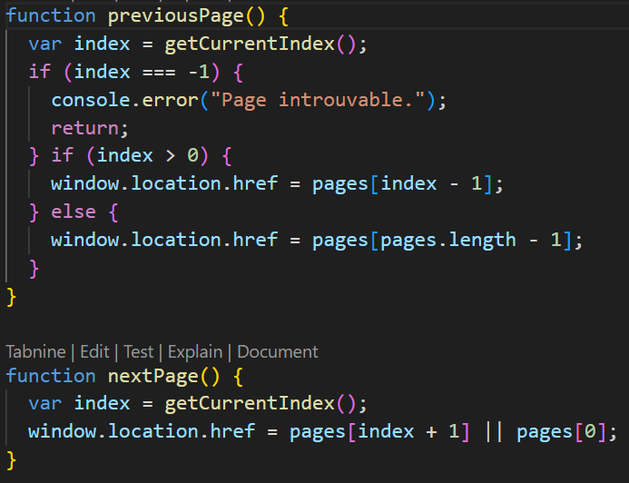

Slide 17
Favicon

Slide 18
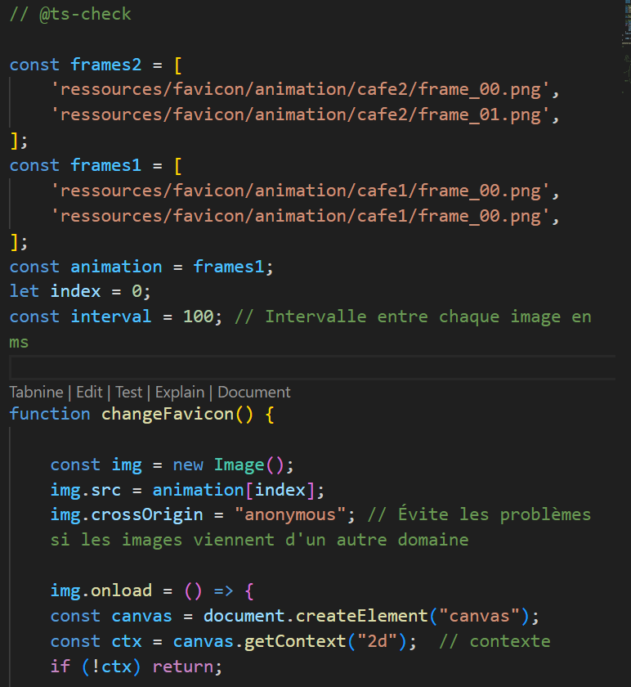
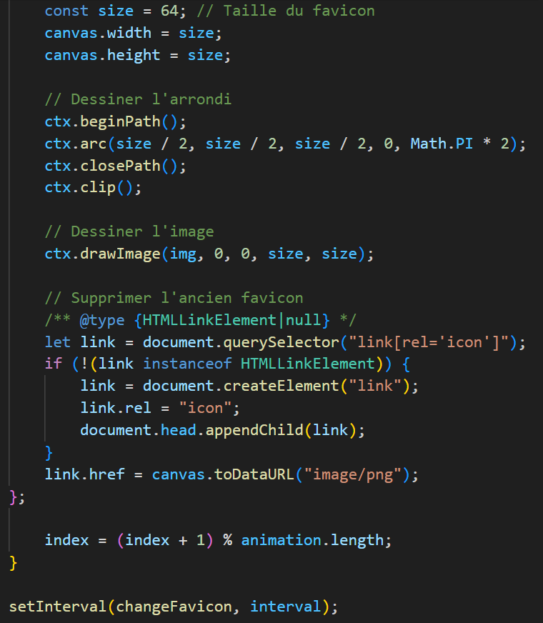

Slide 19


Slide 20
Galerie d’art

Slide 21
,_-=(!7(7/zs_.
.=' ' .`/,/!(=)Zm.
.._,,._.. ,-`- `,\ ` -` -`\\7//WW.
,v=~/.-,-\- -!|V-s.)iT-|s|\-.' `///mK%.
v!`i!-.e]-g`bT/i(/[=.Z/m)K(YNYi.. /-]i44M.
v`/,`|v]-DvLcfZ/eV/iDLN\D/ZK@%8W[Z.. `/d!Z8m
//,c\(2(X/NYNY8]ZZ/bZd\()/\7WY%WKKW) -'|(][%4.
,\\i\c(e)WX@WKKZKDKWMZ8(b5/ZK8]Z7%ffVM, -.Y!bNMi
/-iit5N)KWG%%8%%%%W8%ZWM(8YZvD)XN(@. [ \]!/GXW[
/ ))G8\NMN%W%%%%%%%%%%8KK@WZKYK*ZG5KMi,- vi[NZGM[
i\!(44Y8K%8%%%**~YZYZ@%%%%%4KWZ/PKN)ZDZ7 c=//WZK%!
,\v\YtMZW8W%%f`,`.t/bNZZK%%W%%ZXb*K(K5DZ -c\\/KM48
-|c5PbM4DDW%f v./c\[tMY8W%PMW%D@KW)Gbf -/(=ZZKM8[
2(N8YXWK85@K -'c|K4/KKK%@ V%@@WD8e~ .//ct)8ZK%8`
=)b%]Nd)@KM[ !'\cG!iWYK%%| !M@KZf -c\))ZDKW%`
YYKWZGNM4/Pb '-VscP4]b@W% 'Mf` -L\///KM(%W!
!KKW4ZK/W7)Z. '/cttbY)DKW% -` .',\v)K(5KW%%f
'W)KWKZZg)Z2/,!/L(-DYYb54% ,,`, -\-/v(((KK5WW%f
\M4NDDKZZ(e!/\7vNTtZd)8\Mi!\-,-/i-v((tKNGN%W%%
'M8M88(Zd))///((|D\tDY\\KK-`/-i(=)KtNNN@W%%%@%[
!8%@KW5KKN4///s(\Pd!ROBY8/=2(/4ZdzKD%K%%%M8@%%
'%%%W%dGNtPK(c\/2\[Z(ttNYZ2NZW8W8K%%%%YKM%M%%.
*%%W%GW5@/%!e]_tZdY()v)ZXMZW%W%%%*5Y]K%ZK%8[
'*%%%%8%8WK\)[/ZmZ/Zi]!/M%%%%@f\ \Y/NNMK%%!
'VM%%%%W%WN5Z/Gt5/b)((cV@f` - |cZbMKW%%|
'V*M%%%WZ/ZG\t5((+)L\'-,,/ -)X(NWW%%
`~`MZ/DZGNZG5(((\, ,t\\Z)KW%@
'M8K%8GN8\5(5///]i!v\K)85W%%f
YWWKKKKWZ8G54X/GGMeK@WM8%@
!M8%8%48WG@KWYbW%WWW%%%@
VM%WKWK%8K%%8WWWW%%%@`
~*%%%%%%W%%%%%%%@~
~*MM%%%%%%@f`
'''''

Slide 22
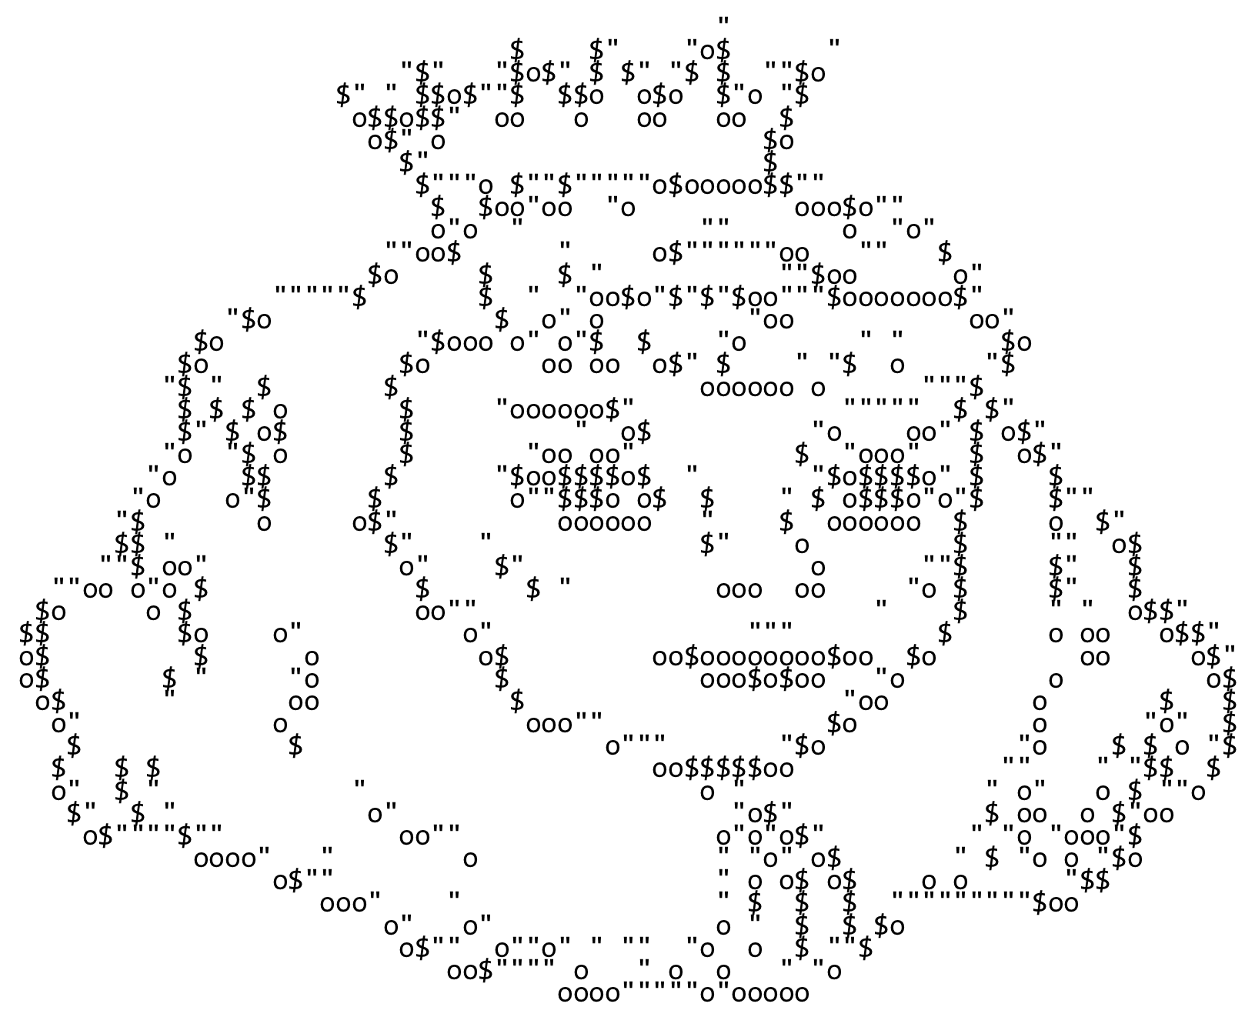

Slide 23
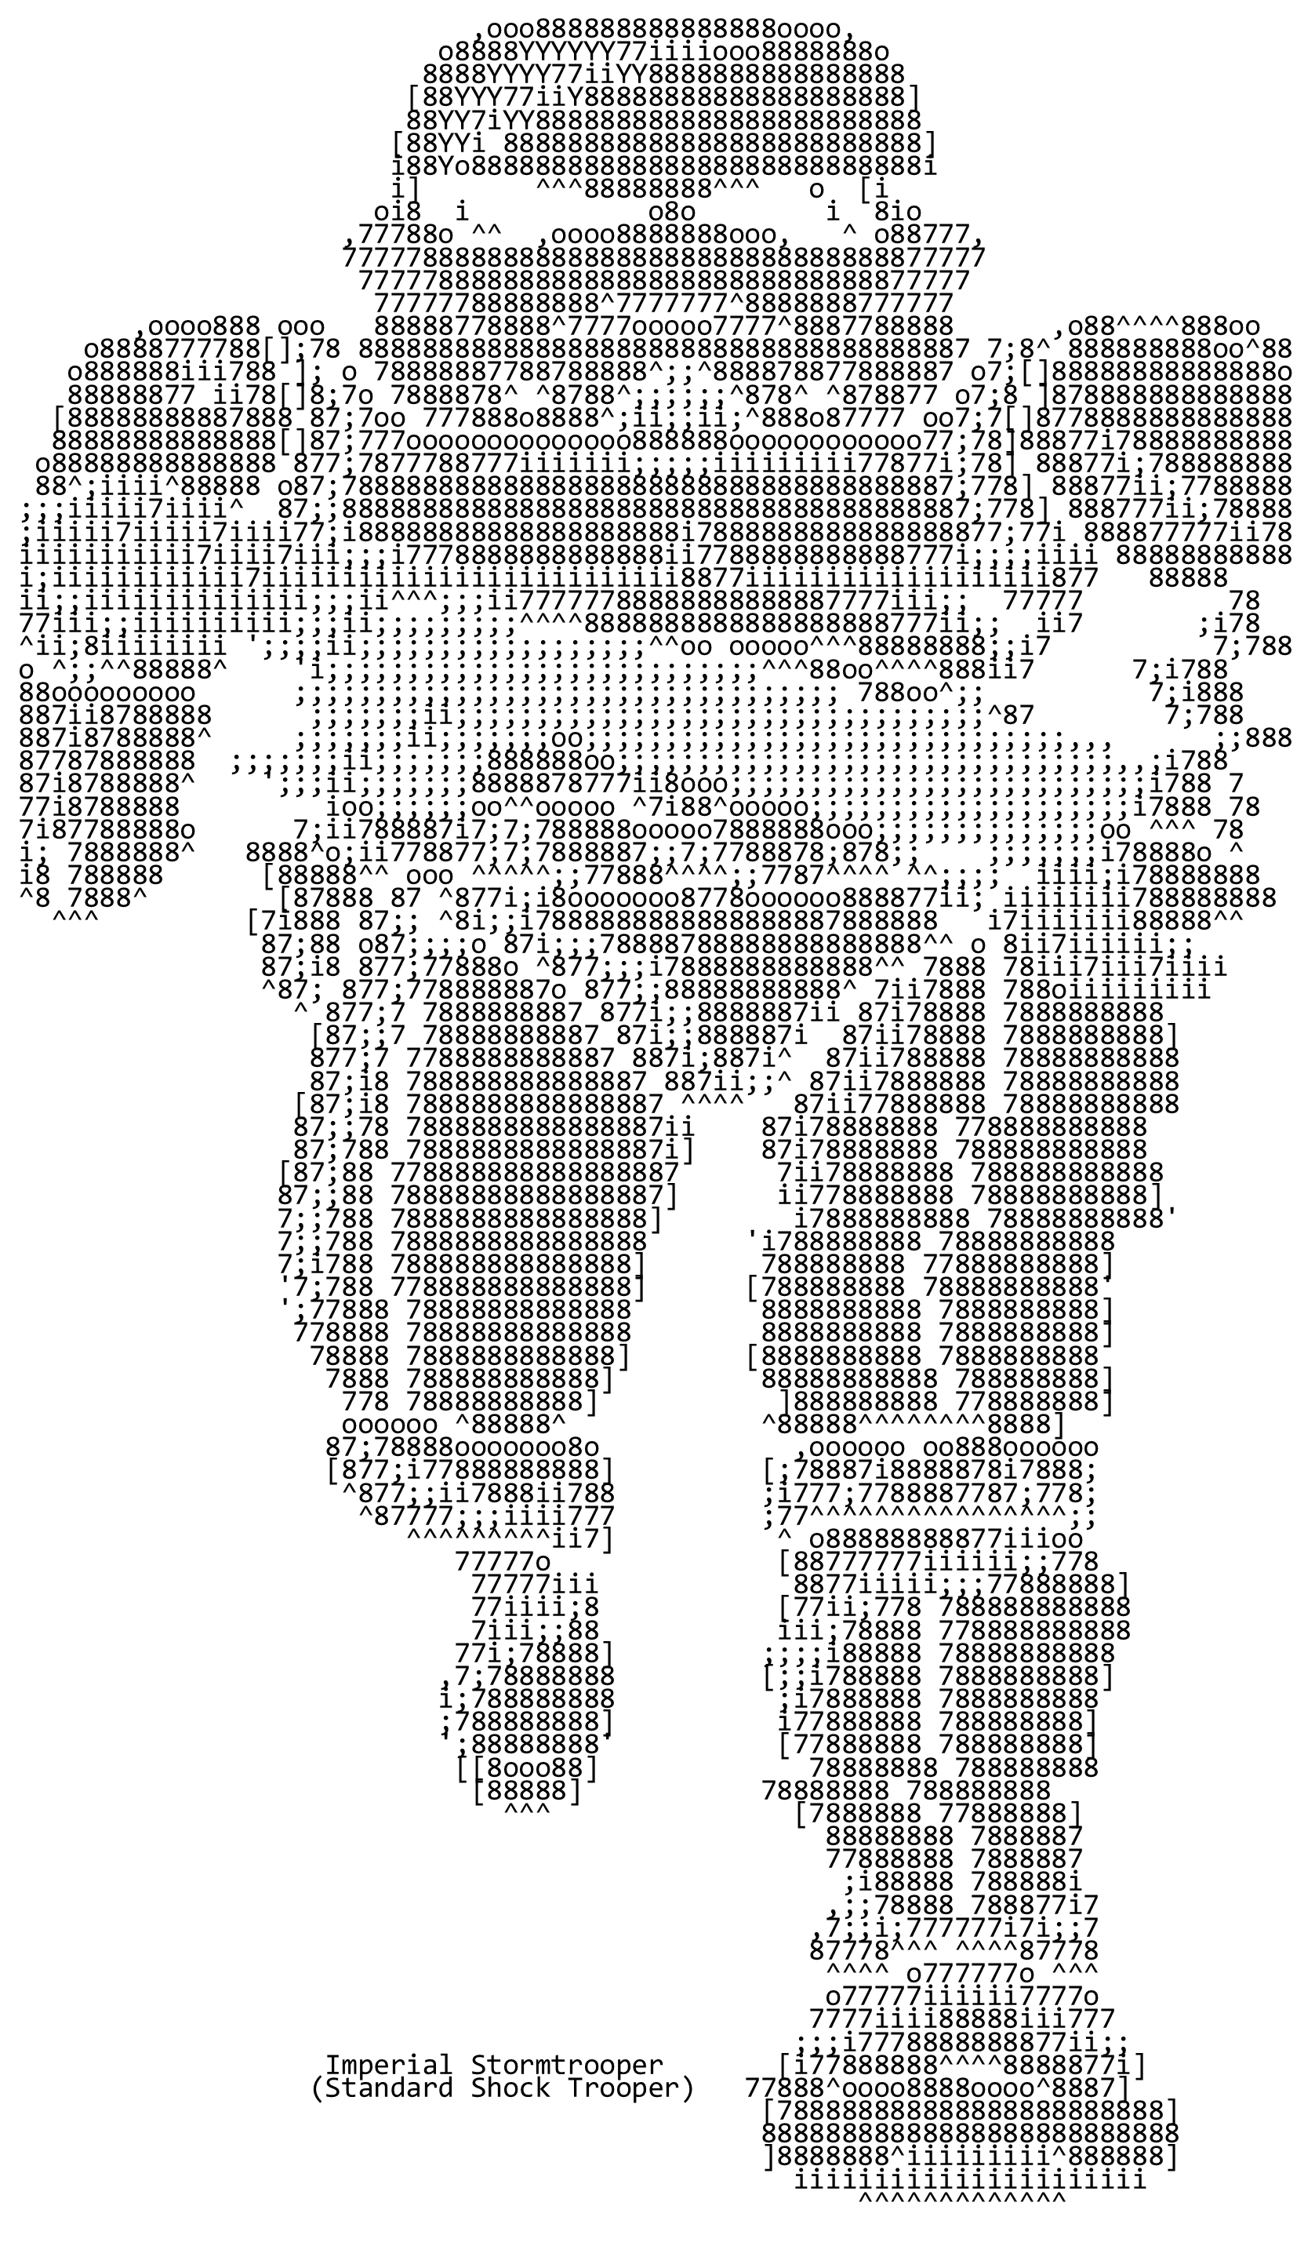

Slide 24
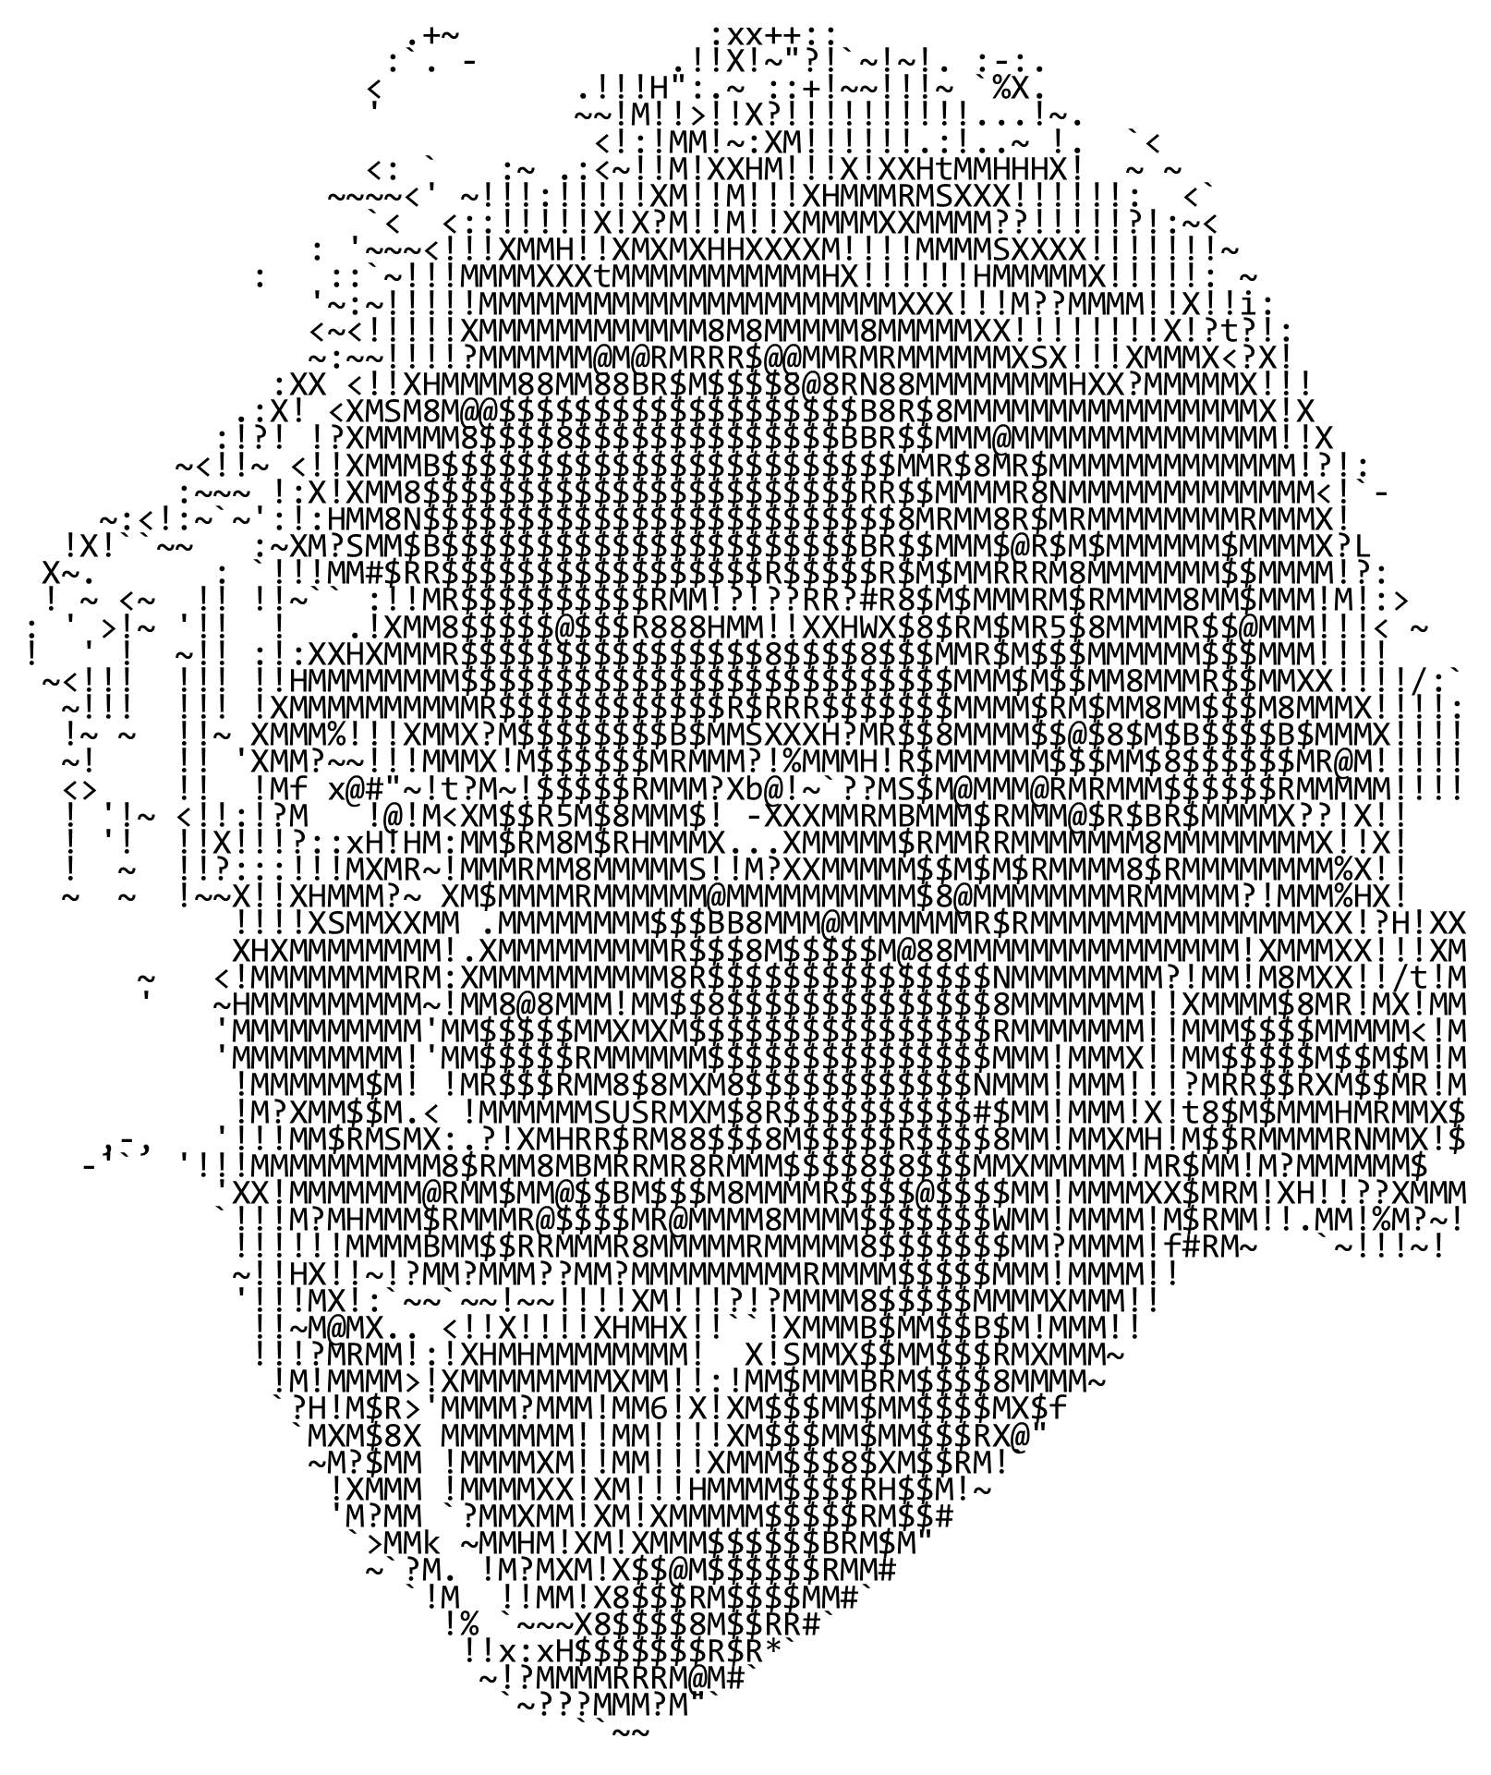

Slide 25
Le meilleur
pour la fin

Slide 26
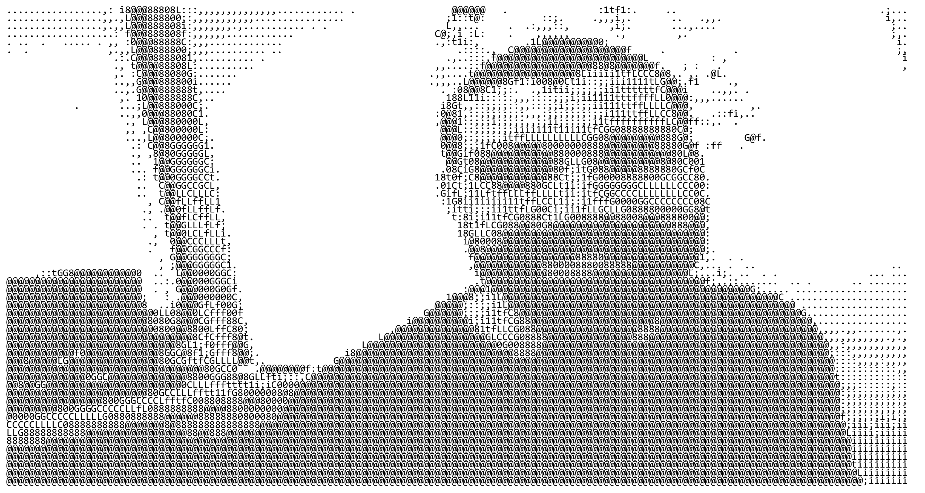

Slide 27

Fin
Retour

